Slide 1
FINANCIAL ANALYSIS PROJECT
Financial Analysis Project in Excel (Documentation)

Slide 2
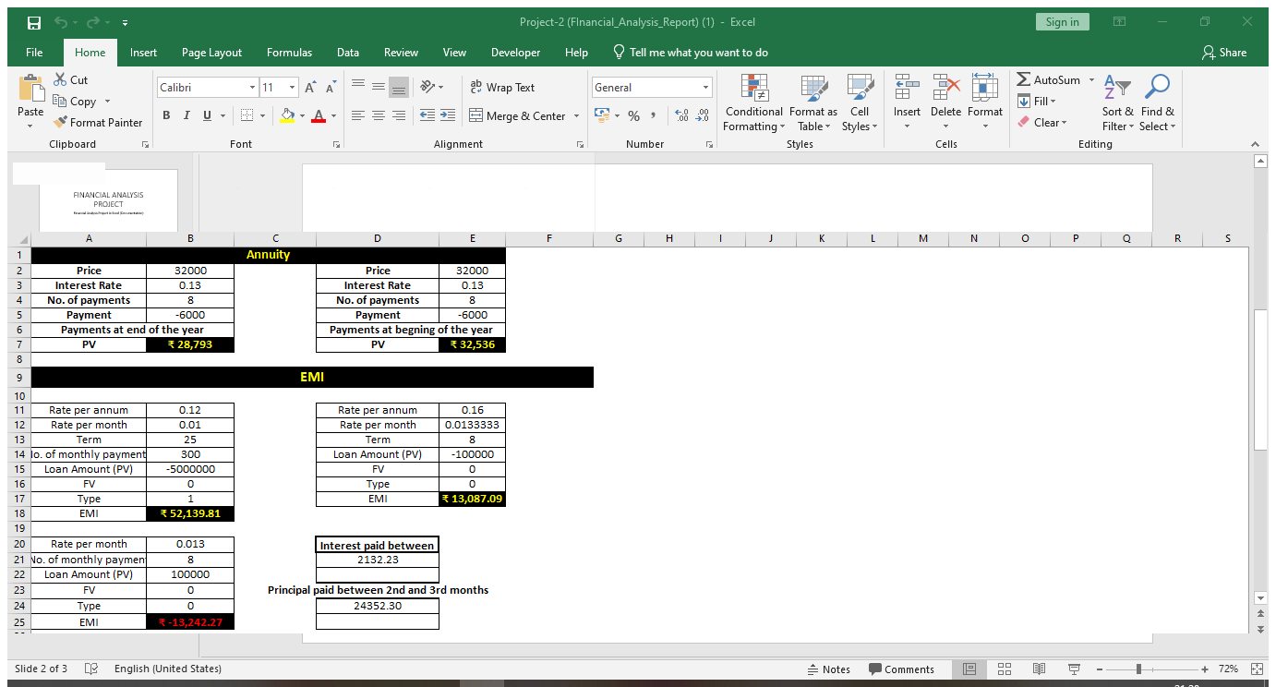
Therefore, If we make the payment now, need to pay 32,000 of present value. If opt for yearly payments with payment at the end of the year, need to pay 28, 793 of present value. If opt for yearly payments with payment at the begging of the year, need to pay 32,536 of present value. So can clearly see that option 2 is beneficial for us.

Slide 3
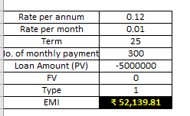
Suppose, want to take a home loan of Rs 5000000 with an annual interest rate of 11.5% and the term of the loan for 25 years. We can find EMI Rs 52139.81.

Slide 4
Monthly Payment of Principal and Interest on a Loan EMI includes both-interest and a part payment of principal. As the time increases, these two components of EMI will vary, reducing the balance.

Slide 5
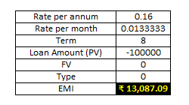
If taken a loan of 1,000,000 for a term of 8 months at the rate of 16% per annum. We can get values for the EMI, the decreasing interest amounts, the increasing payment of principal amounts and the diminishing loan balance over the 8 months. At the end of 8 months, loan balance will be 0. This results in an EMI of Rs. 13087.09

Slide 6
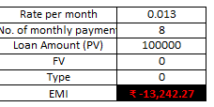
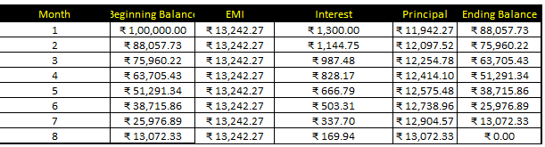
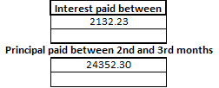
The interest and principal parts of the EMI for the 8 months as shown on above.
The cumulative interest paid between 2nd and 3rd months done bellow.

Slide 7

Suppose you take a loan of 100,000 at the interest rate 10%. You want a maximum monthly payment of 15,000. You might want to know how long it will take for you to clear the loan. Find the number of payments with Excel NPER function. We get the result as 12 months.
When want to make an investment, compare the different options and choose the one that yields better returns. Net present value is useful in comparing cash flows over a period of time and deciding which one is better. The cash flows can occur at regular, periodical intervals or at irregular intervals. First, we consider the case of regular, periodical cash flows. The net present value of a sequence of cash flows received at different points in time.

Slide 8
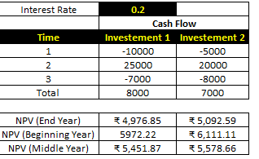
At face value, Investment 1 looks better than Investment 2. However, I can decide on which investment is better only when I know the true worth of the investment as of today. I can use the NPV function to calculate the returns. The cash flows can occur At the end of every year. At the beginning of every year. In the middle of every year. NPV function assumes that the cash flows are at the end of the year. If the cash flows occur at different

Slide 9
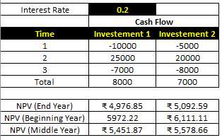
As observed NPV for Investment 2 is higher than that for Investment 1. Hence, Investment 2 is a better choice. I got this result as cash out flows for Investment 2 are at later periods as compared to that of Investment 1 Cash Flows at the Beginning of the Year. Suppose the cash flows occur at the beginning of every year. In such a case, should not include the first cash flow in NPV calculation as it already represents the current value. I need to add the first cash flow to the NPV obtained from rest of the cash flows to get the net present value.

Slide 10
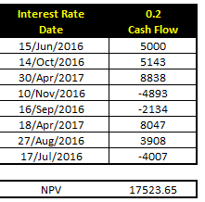
Example of Cash Flows at Irregular Intervals

Slide 11
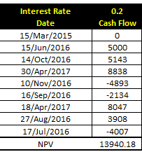
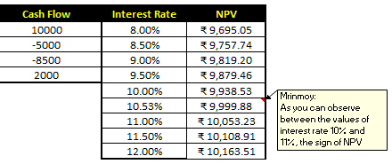
Suppose today’s date is 15th March, 2015. As observed, all the dates of cash flows are of later dates. If I want to find the net present value as of today, I include it in the data at the top and specify 0 for the cash flow. As you can observe between the values of interest rate 10% and 11%, the sign of NPV changes. When you fine-tune the interest rate to 10.53%, NPV is nearly 0. Hence, IRR is 10.53%.

Slide 12
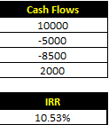
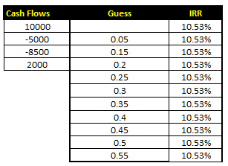
Determining IRR of Cash Flows for a Project i can calculate IRR of cash flows with Excel function IRR.
Unique IRR
If IRR exists and is unique, it can be used to choose the best investment among several possibilities. If the first cash flow is negative, it means the investor has the money and wants to invest. Then, the higher the IRR the better, since it represents the interest rate the investor is receiving. If the first cash flow is positive, it means the investor needs money and is looking for a loan, the lower the IRR the better since it represents the interest rate the investor is paying. To find if an IRR is unique or not, I did vary the guess value and calculate IRR. If IRR remains constant then it is unique.
As observe, the IRR has a unique value for the different guess values

Slide 13
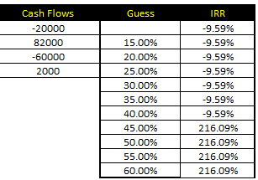

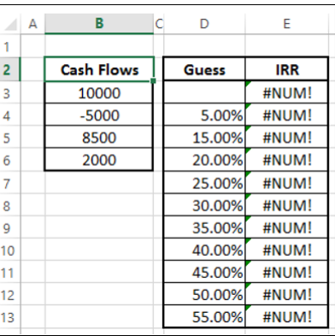
Multiple IRRs In certain cases, we may have multiple IRRs. Consider the following cash flows. Calculating IRR with different guess values.
It can observe that there are two IRRs - -9.59% and 216.09%.
So I can verify these two IRRs calculating NPV.
For both -9.59% and 216.09%, NPV is 0.
No IRRs, In certain cases, we may not have IRR.
Consider the following cash flows.
Calculating IRR with different guess values.
The result #NUM means that there is no IRR for the cash flows considered.

Slide 14
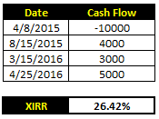
Cash Flows Patterns and IRR, If there is only one sign change in the cash flows, such as from negative to positive or positive to negative, then a unique IRR is guaranteed. For example, in capital investments, the first cash flow will be negative, while the rest of the cash flows will be positive. In such cases, unique IRR exists. If there is more than one sign change in the cash flows, IRR may not exist. Even if it exists, it may not be unique.
Decisions based on IRRs
IRR is a popular profitability measure because, as a percentage, it is easy to understand and easy to compare to the required return. However, there are certain problems while making decisions with IRR. If rank with IRRs and make decisions based on these ranks, may end up with wrong decisions, which have already seen that NPV will enable to make financial decisions. However, IRR and NPV will not always lead to the same decision when projects are mutually exclusive. Mutually exclusive projects are those for which the selection of one project precludes the acceptance of another. When projects that are being compared are mutually exclusive, a ranking conflict may arise between NPV and IRR. If have to choose between project A and project B, NPV may suggest acceptance of project A whereas IRR may suggest project B.
IRR of Irregularly Spaced Cash Flows (XIRR), cash flows may sometimes be irregularly spaced. In such a case, cannot use IRR as IRR requires equally spaced time intervals. Need to use XIRR instead, which takes into account the dates of the cash flows along with the cash flows.

Slide 15
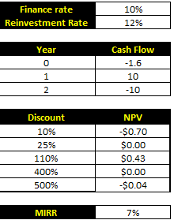
Modified IRR (MIRR)
Consider a case when the finance rate is different from reinvestment rate. If calculate Internal Rate of Return with IRR, it assumes same rate for both finance and reinvestment. Further, might also get multiple IRRs. For example, considering the cash flows given below ,
As observe, NPV is 0 more than once, resulting in multiple IRRs. Further, reinvestment rate is not taken into account. In such cases, I can use modified IRR (MIRR).

Slide 16
Conclusion:
Optimized Financing Strategies:
Businesses can reduce costs significantly by selecting appropriate payment structures. For example, paying at the end of the year for loans offers a lower present value obligation, improving cash flow management.
Investment Prioritization:
Net Present Value (NPV) stands out as a superior metric for evaluating investment opportunities. By focusing on the true value of cash flows over time, businesses can prioritize projects with higher long-term returns, even when upfront costs seem higher.
Decision-Making Frameworks:
Internal Rate of Return (IRR) provides a straightforward profitability measure but may lead to inconsistencies in project selection, particularly in mutually exclusive scenarios. Businesses are advised to use NPV as the primary tool to align decisions with overall financial goals.
Advanced Financial Metrics for Complexity:
For projects with non-uniform cash flows or differing reinvestment and finance rates, Modified IRR (MIRR) offers a more accurate assessment, aiding in complex capital budgeting decisions.
Loan and Cash Flow Management:
Detailed loan analyses underline the importance of understanding principal and interest dynamics to maintain liquidity and manage debt efficiently.
Professional Insight:
This project equips businesses with robust analytical tools to make informed financial decisions. By prioritizing NPV for investment appraisals, leveraging MIRR for nuanced evaluations, and optimizing loan repayments, companies can maximize profitability, strengthen financial stability, and drive strategic growth.

